Slide 1
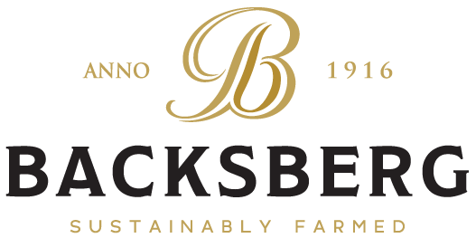
An overview

Slide 2
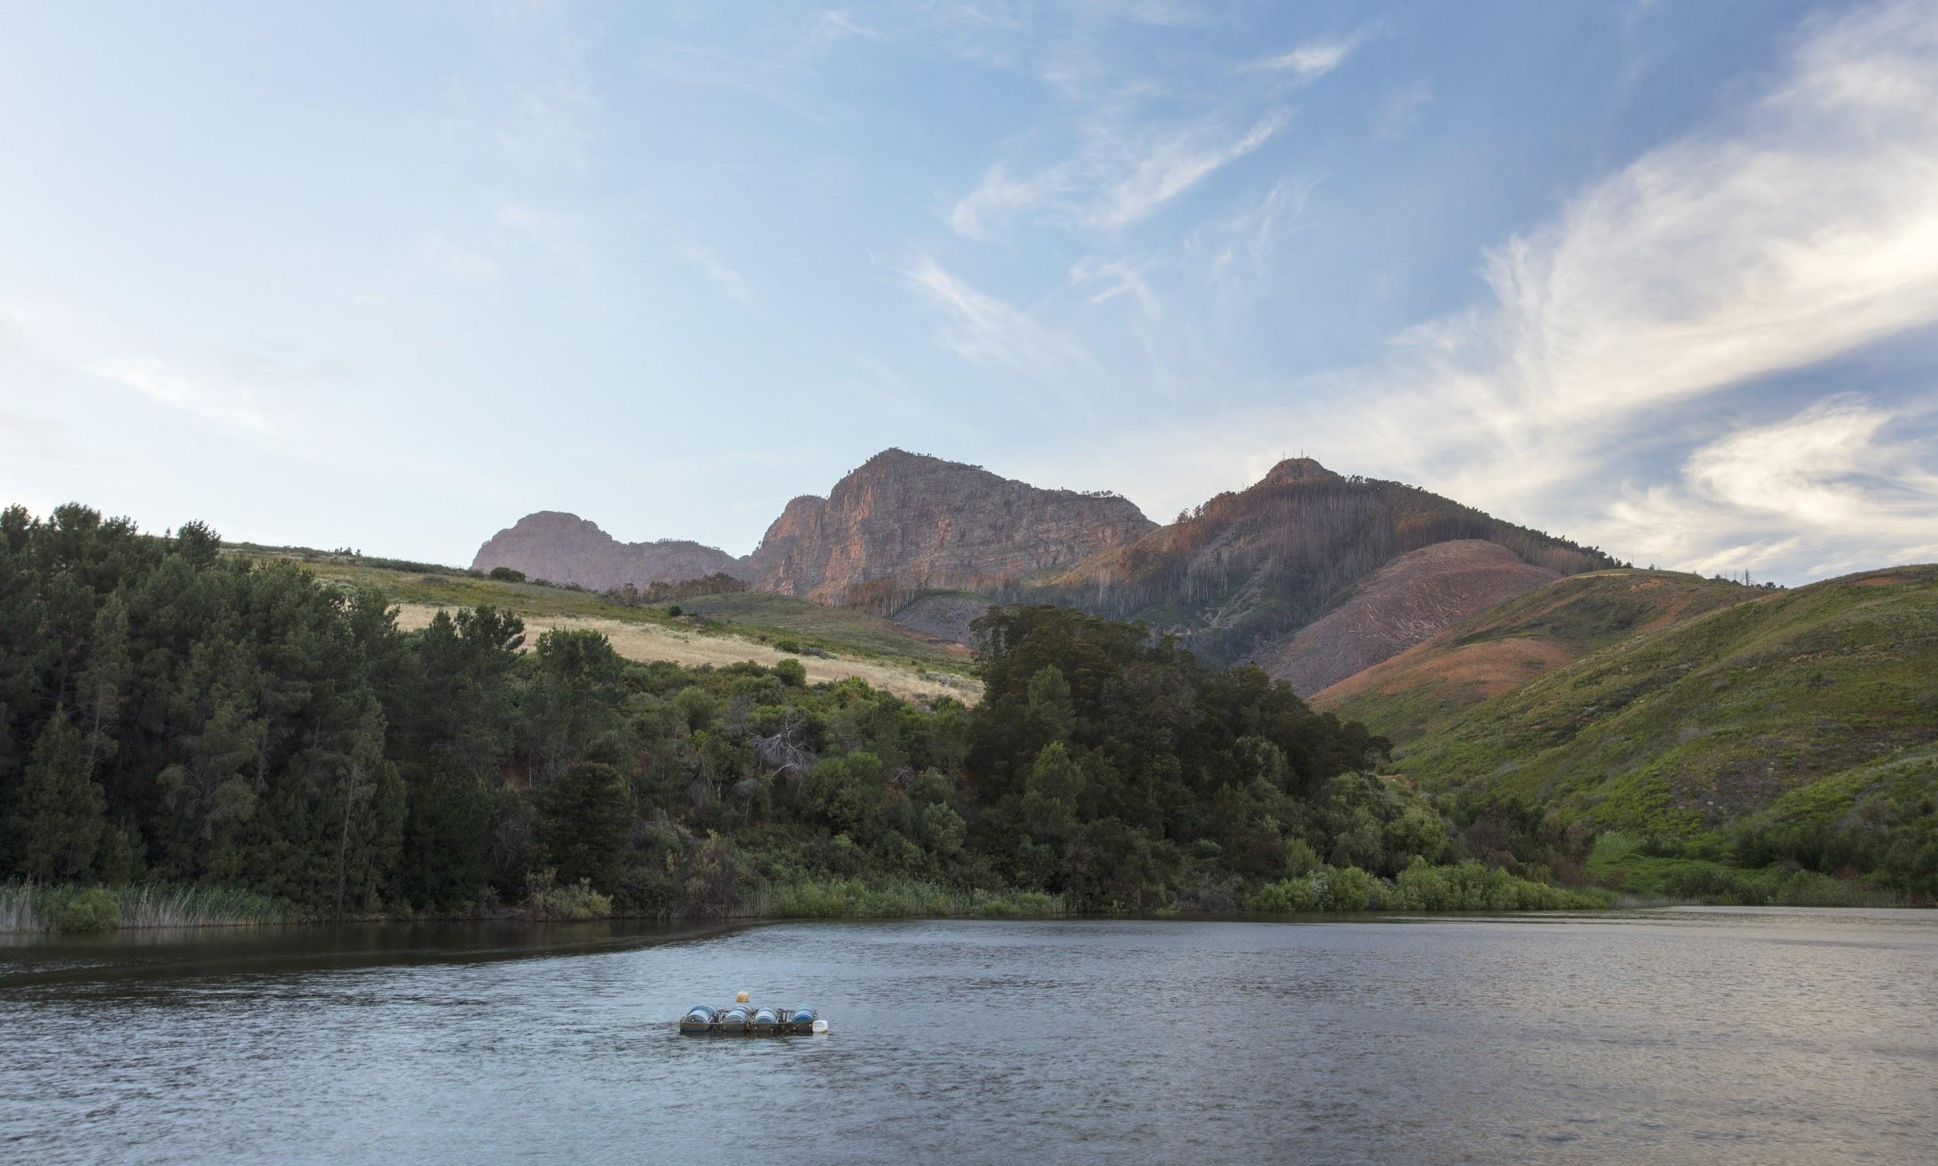
Situated beneath the Simonsberg in the heart of the Cape Winelands.
Paarl, South Africa.

Slide 3
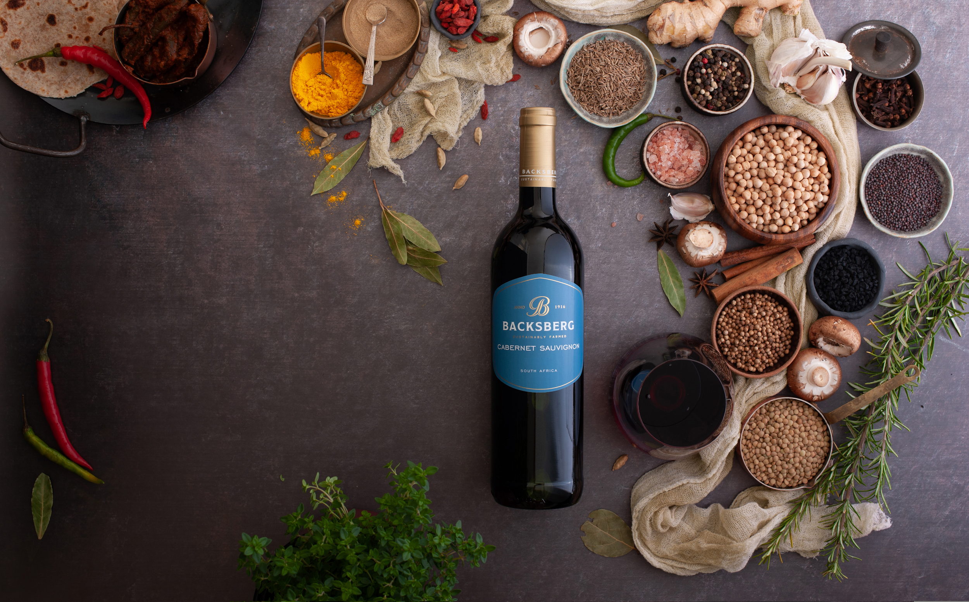
“Making fine wine an everyday pleasure.”

Slide 4
Nestled on the slopes of the Simonsberg Mountain, equidistant to the cosy Winelands towns of Stellenbosch, Franschhoek and Paarl, in the Western Cape of South Africa; Backsberg Estate Cellars maintains 80 hectares under vine and produces a selection of tiered wine and brandy offerings from the region.
As a winery of over 100 years, Backsberg’s philosophy remains to provide pleasure and enjoyment to a broad range of wine lovers by producing wines with not only structure and finesse, but also with a high level of drinkability.

Slide 5
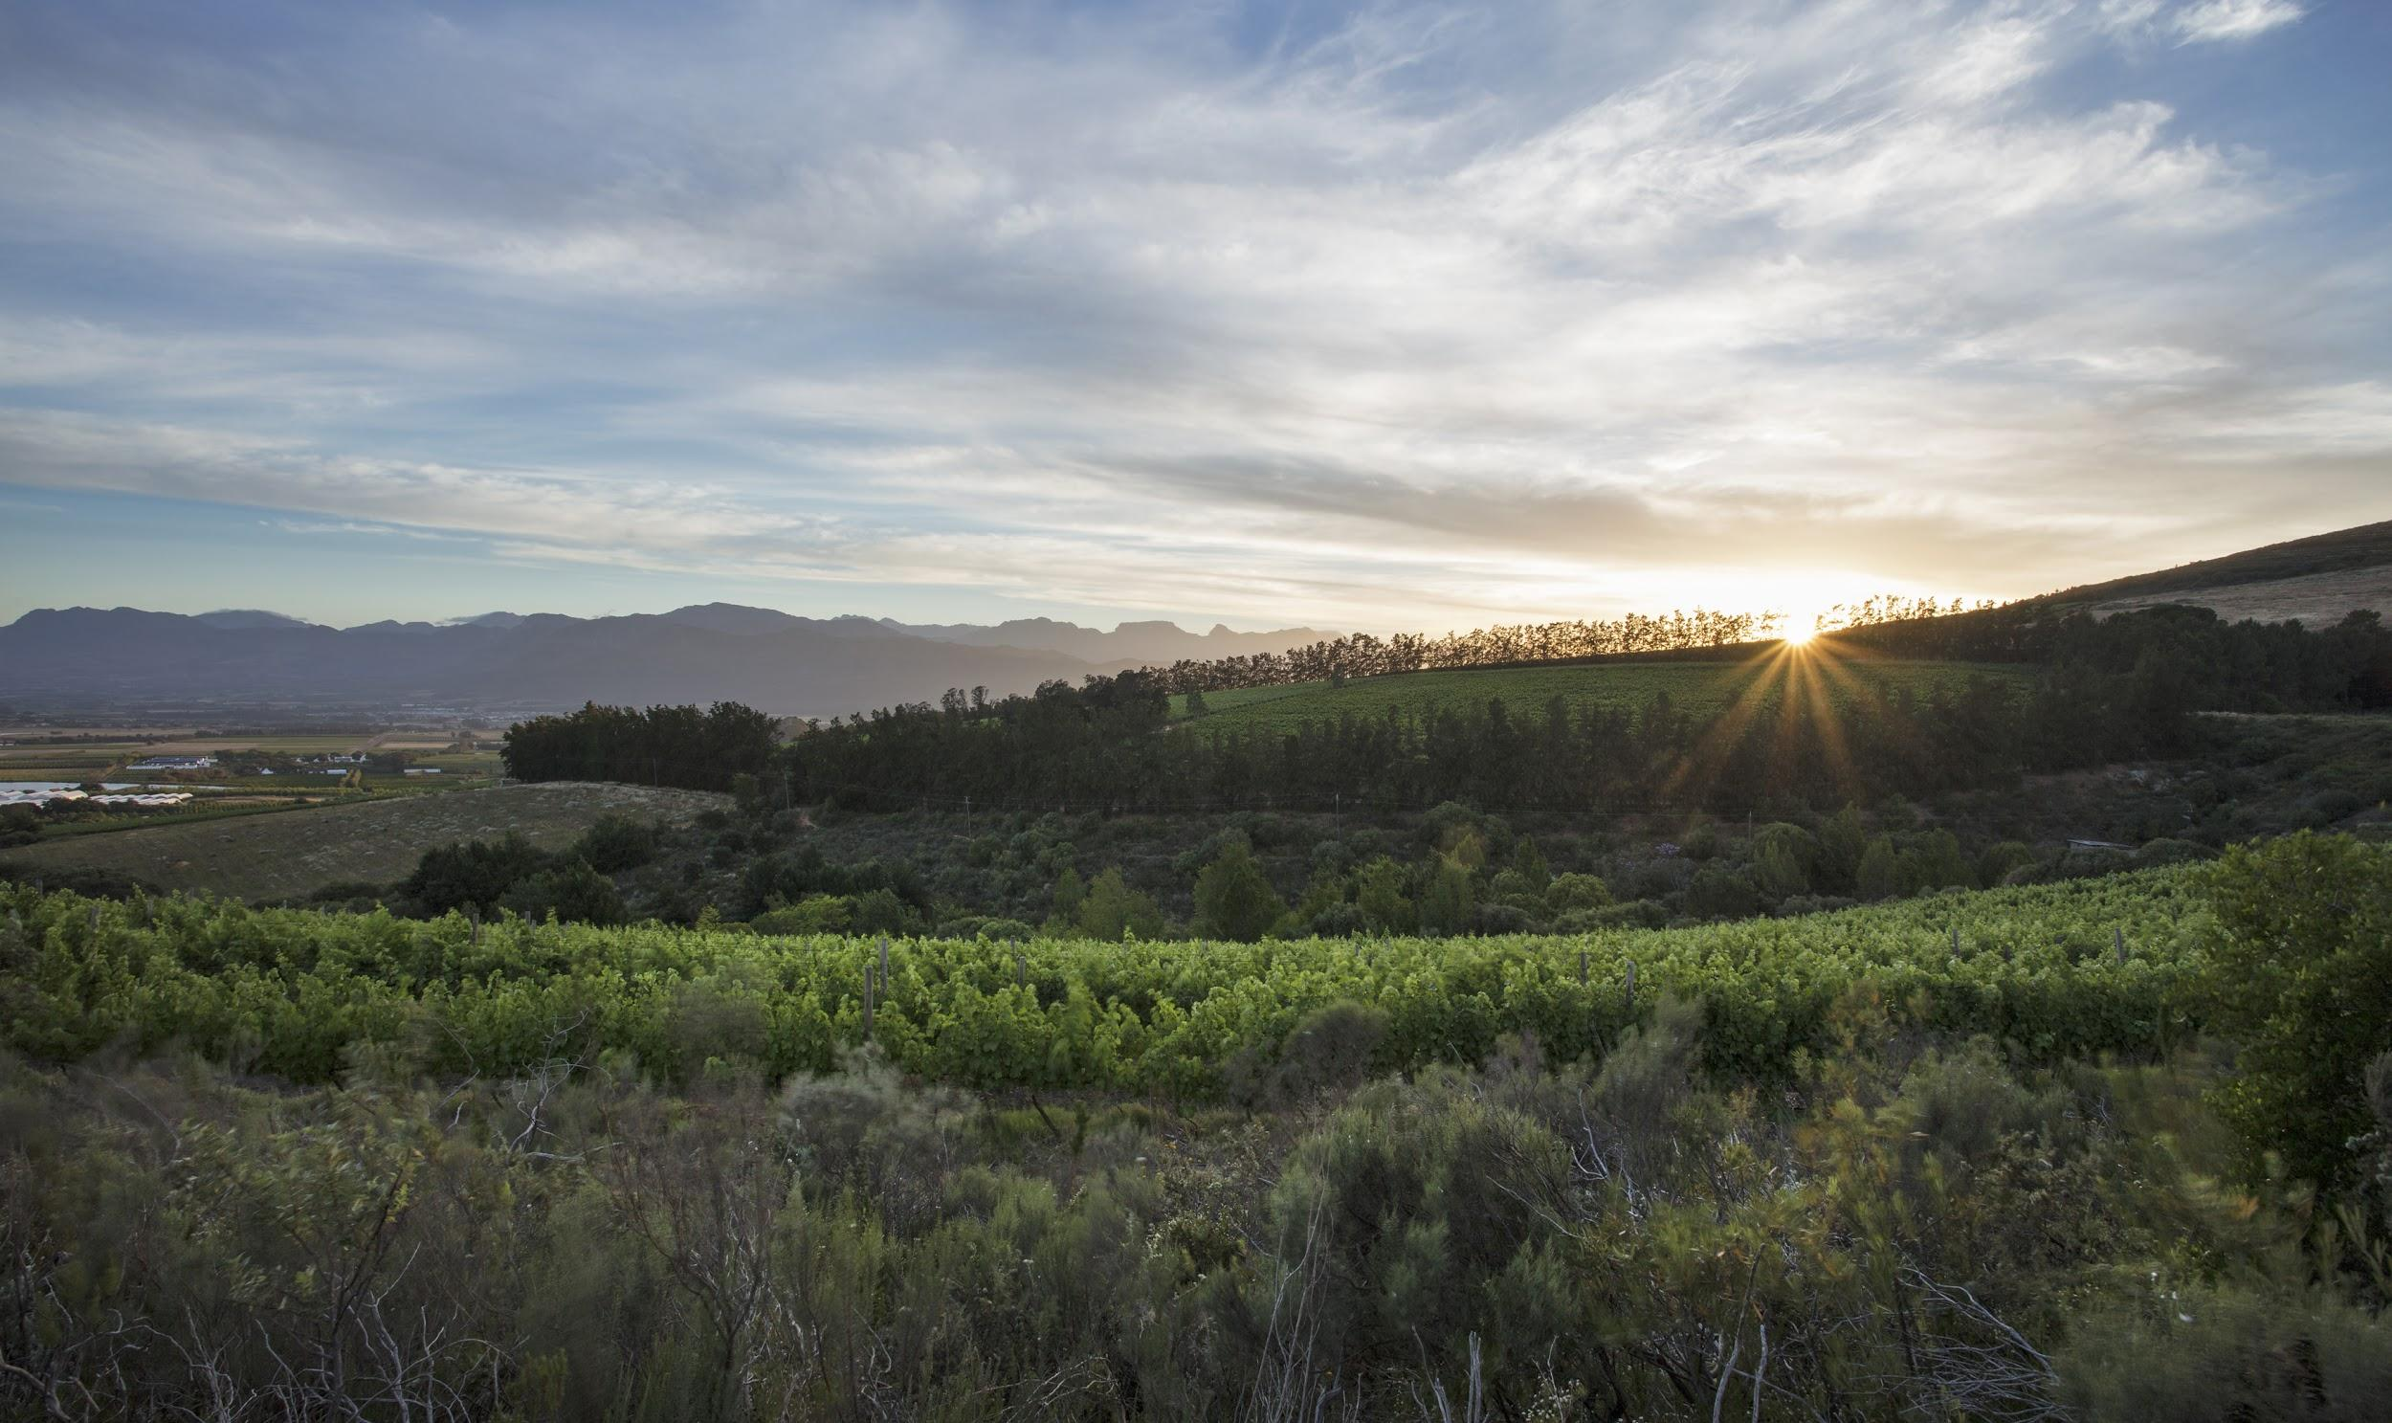
“Care for the environment means care and concern for succeeding generations. As custodians of the land, it is our duty to understand and recognise potential threats, and to mitigate against them for the benefit of the next generation.” - Michael Back

Slide 6
Backsberg - Sustainably Farmed
“Care for the environment means care and concern for succeeding generations.” - Michael Back
This philosophy exists under an overall umbrella of care - care for the land, the product and the employee. As South Africa’s very first carbon neutral winery, and a proud WWF Conservation Champion, Backsberg places great importance on a sustainable future for all.

Slide 7
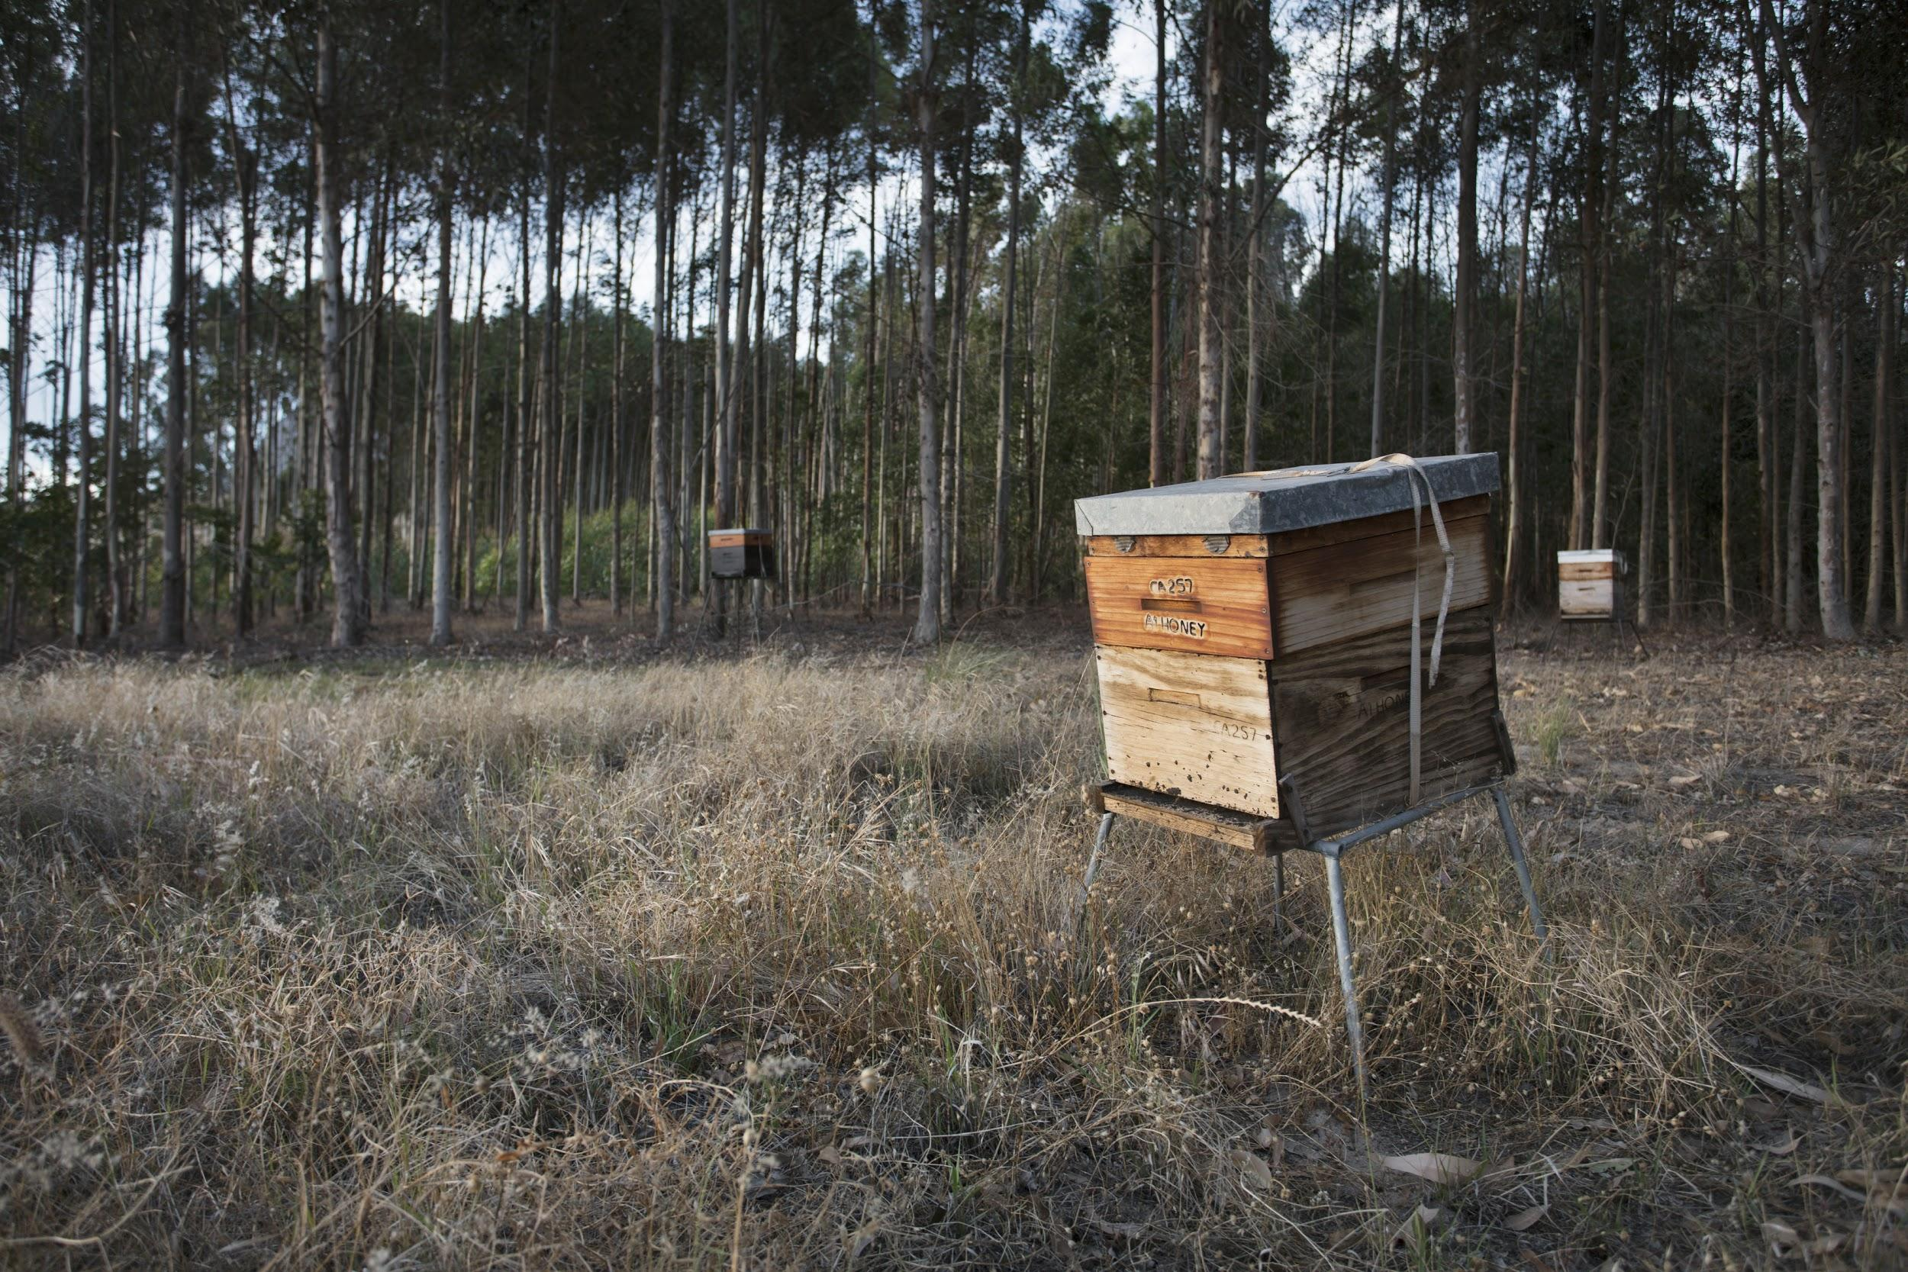

Slide 8
Backsberg - A family-owned winery situated in the heart of the Cape Winelands
The Back family business was founded by Charles Louis Back - who came to South Africa as a penniless, illiterate, Jewish refugee from Lithuania - in 1902. Sydney Back, his son, took over in 1942 and Michael Back, the grandson, joined the fold in 1976. Simon Back, now the fourth generation, is the current CEO of Backsberg and it is the hope that his son, Eli Back, will continue the legacy in future.
Over the years the estate has gone through many iterations since its purchase by CL Back in 1916. In its 104 years, it has been a mixed farming operation - from fruit to grapes and even livestock - but today the focus is on the wine business. Celebrating four generations of family ownership, and several decades of quality winemaking, Backsberg continues to thrive by honouring the past whilst simultaneously forging ahead with forward-thinking holistic practices.

Slide 9
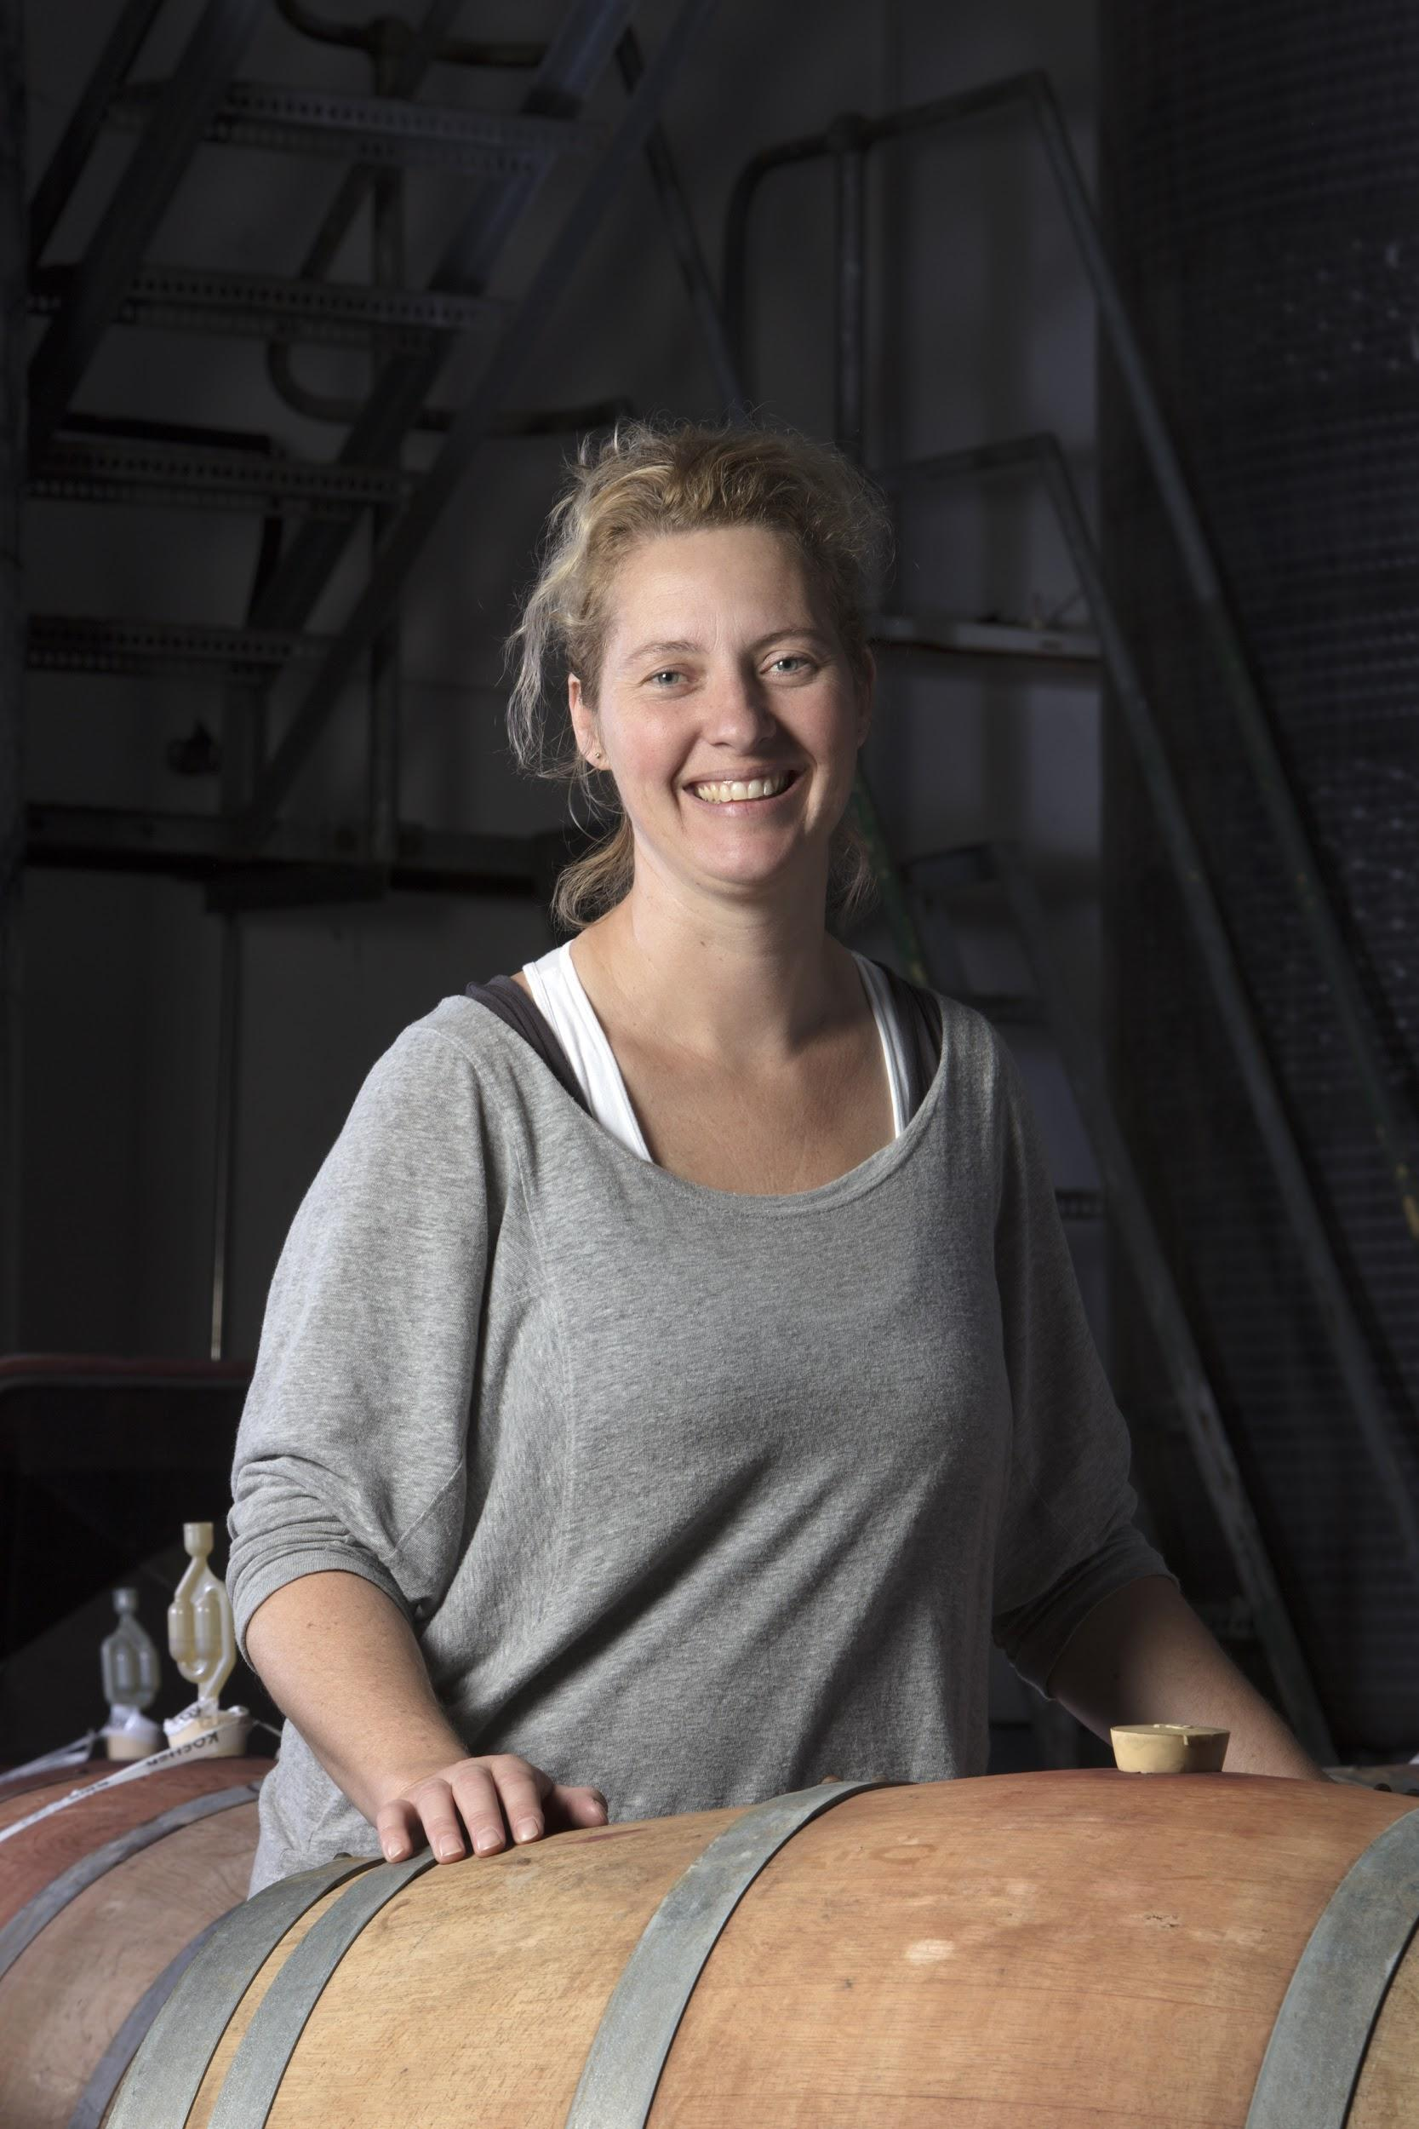
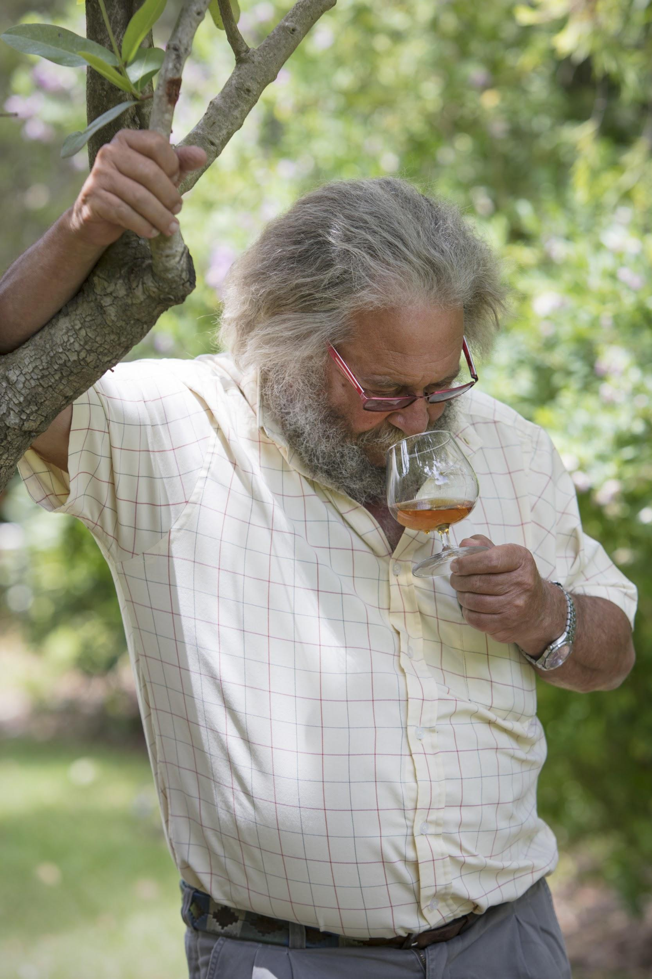
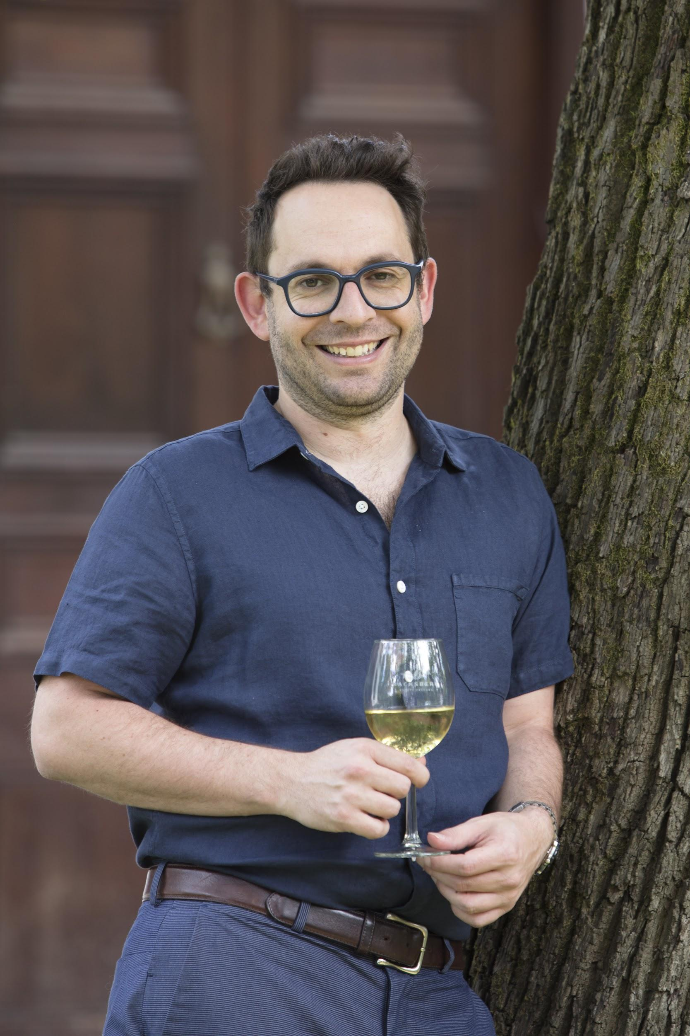
Production & Beyond
Owners: Michael & Simon Back
Winemaker: Alicia Rechner
Total annual production: 75 000 cases of 12 (or an estimated 900 000 litres)
Soil composition: Predominantly decomposed granite soils
Climate: Mediterranean (mild, wet winters and hot, dry summers)

Slide 10
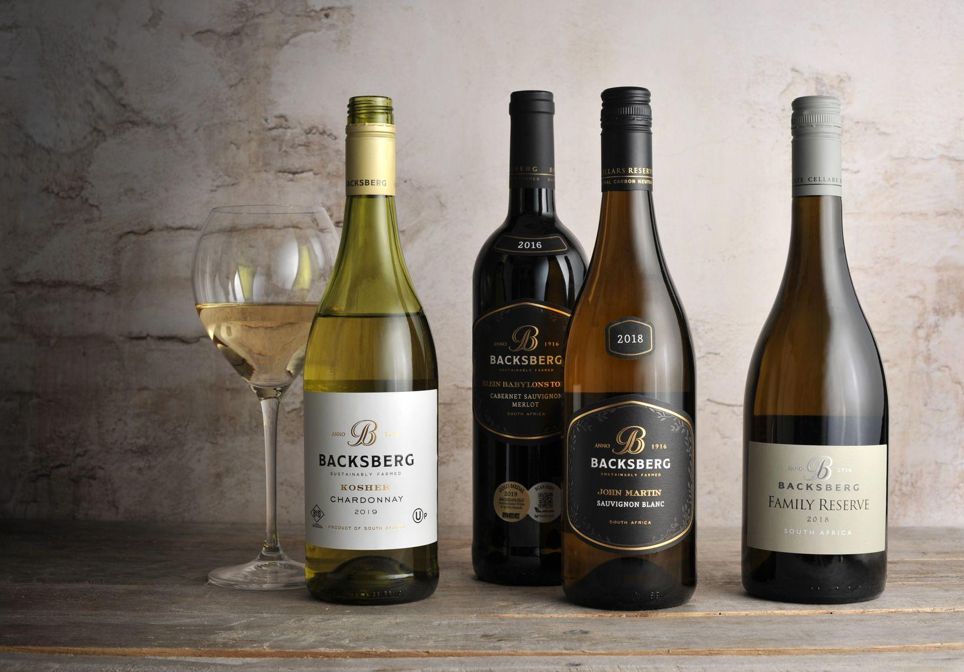

Slide 11
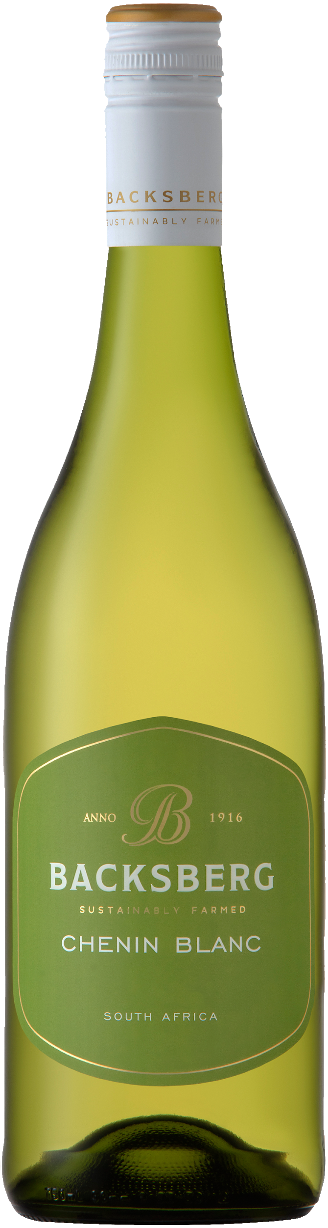
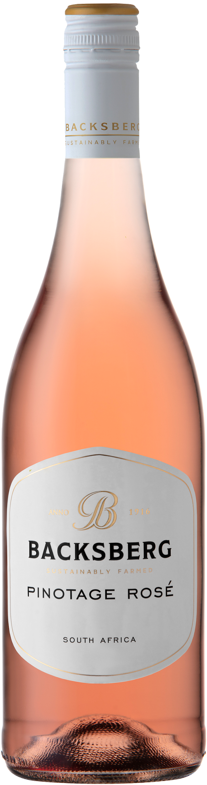
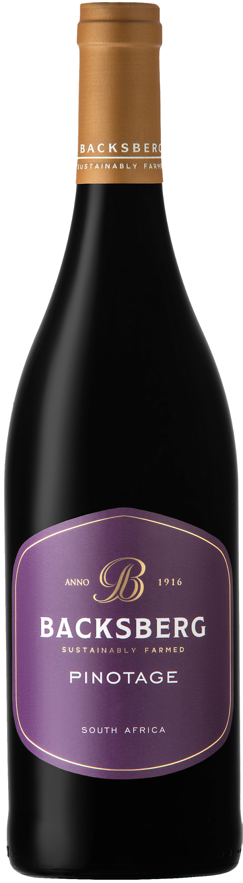
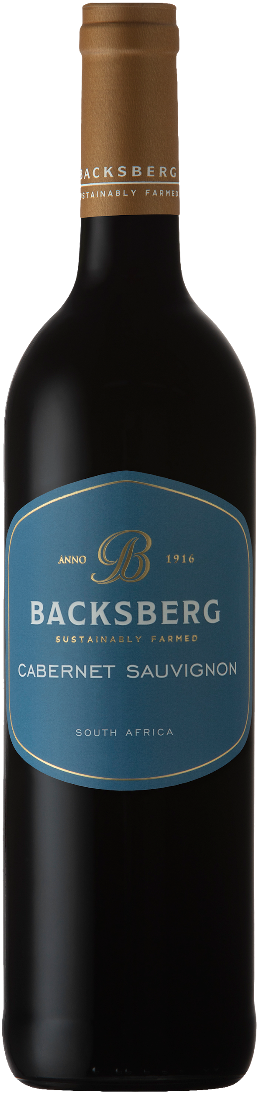
Backsberg Premium Range
Backsberg’s Premium Range is a single-varietal wine range. The objective with this range is to produce wines that express varietal character together with a sense of place, in an elegant and harmonious style.

Slide 12
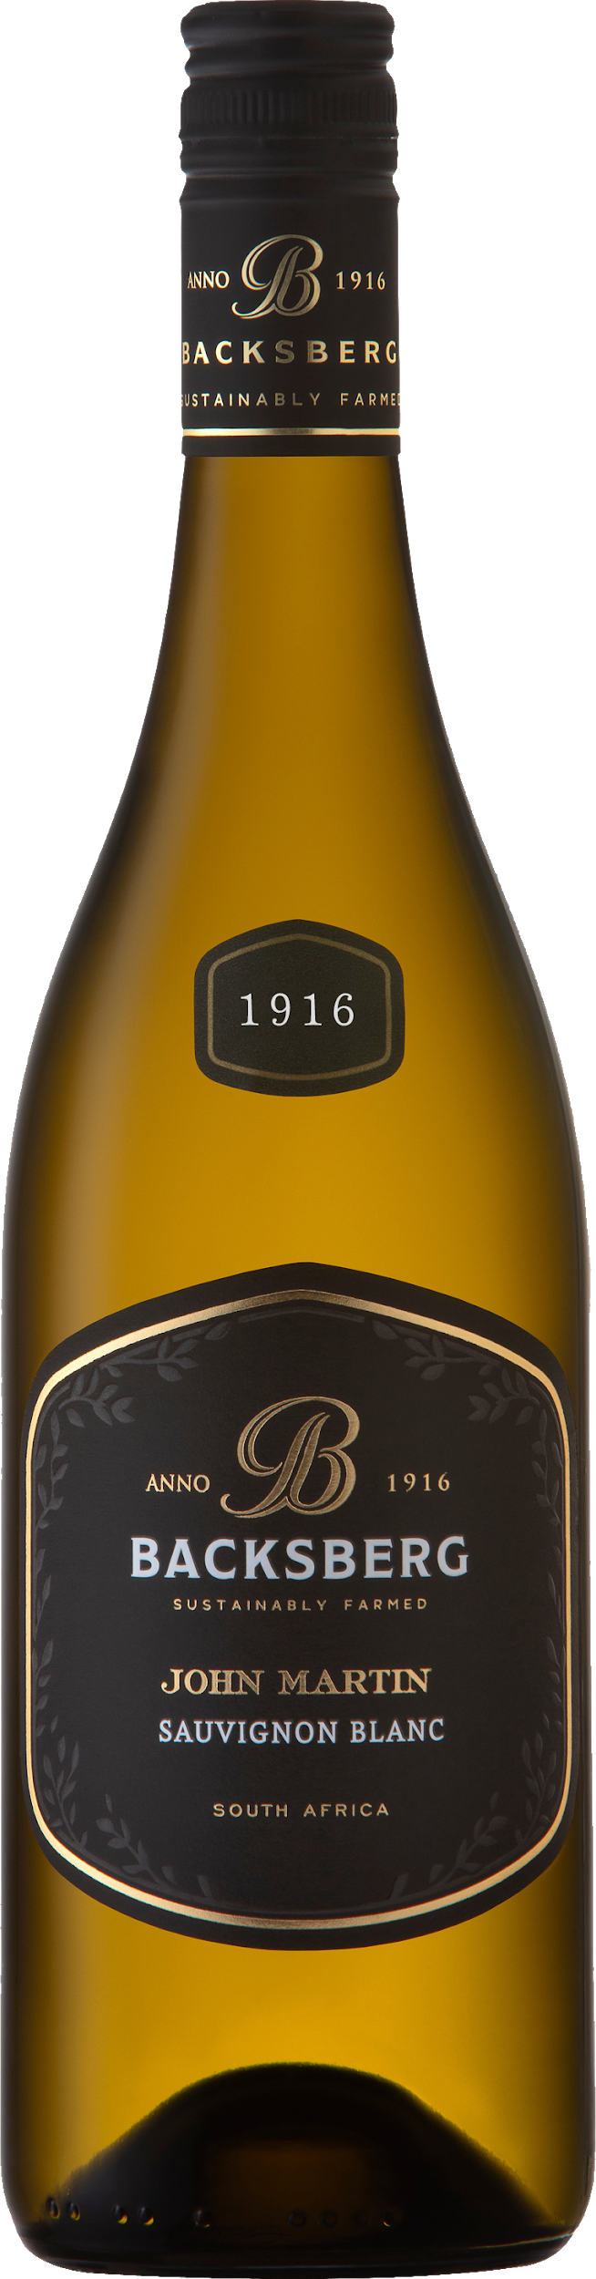
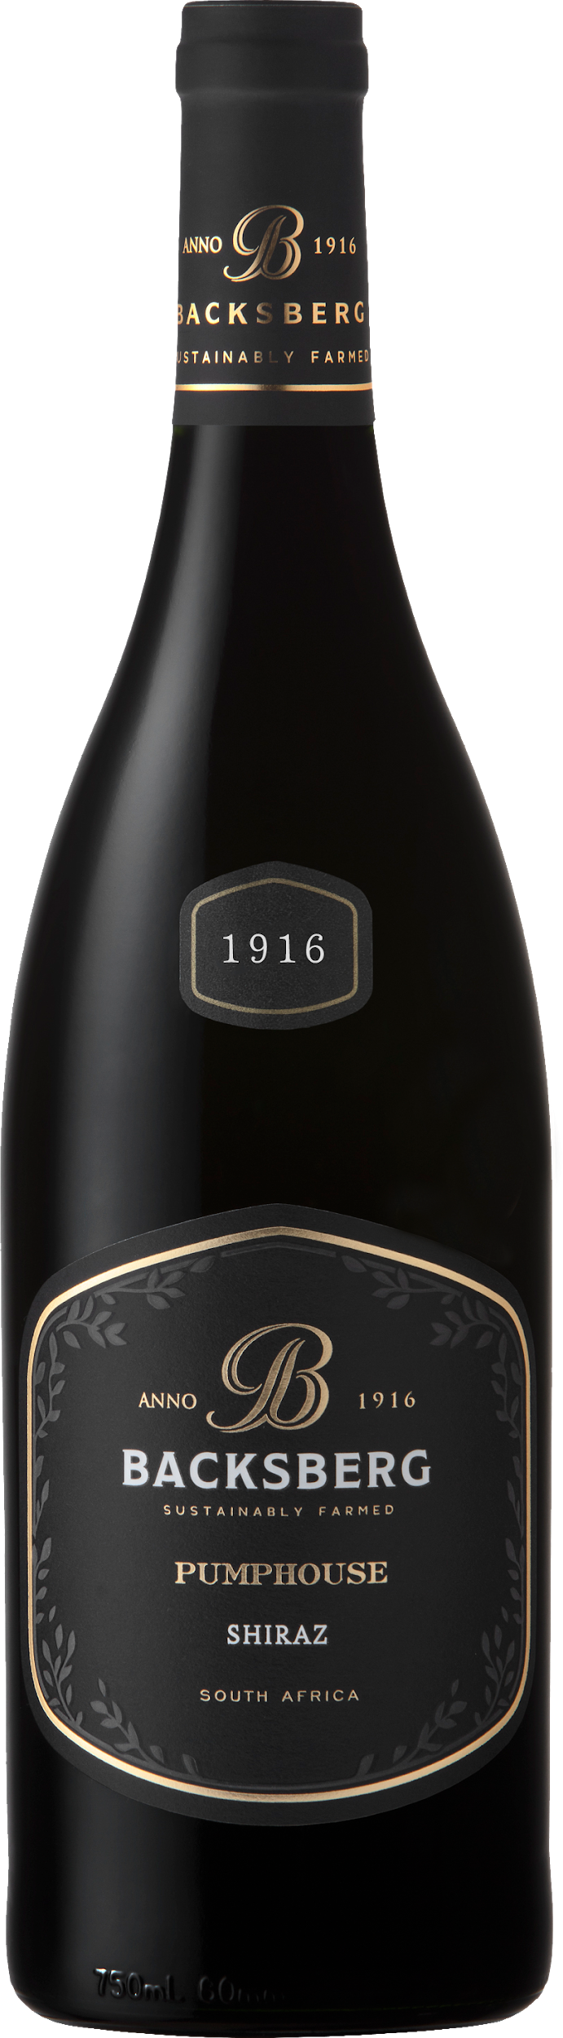
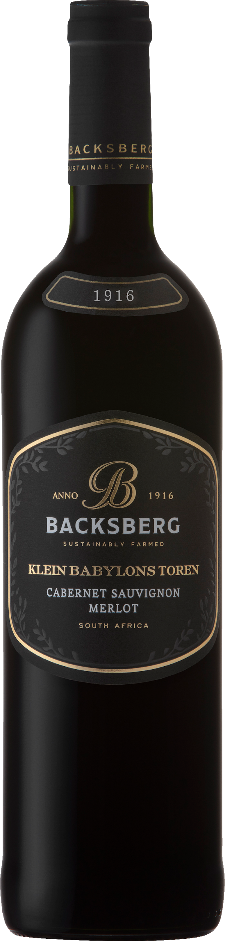
Backsberg Black Label Range
The grapes for this range have been selected from top-performing vineyards and produce individual, exciting wines. Underscoring this notion of individuality, the wines are named after places or persons of significance to the farm and its rich historical past. While offering much enjoyment on release, the whites will benefit from 2 to 3 years of cellaring, while the reds will benefit from 8 to 10 years of maturation.

Slide 13
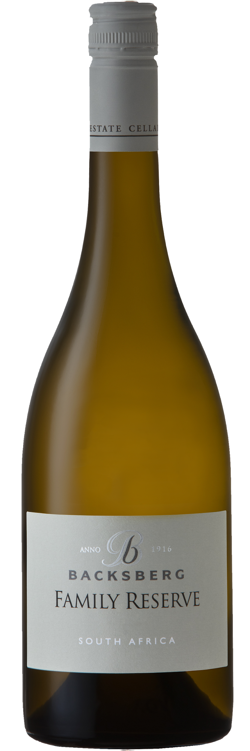
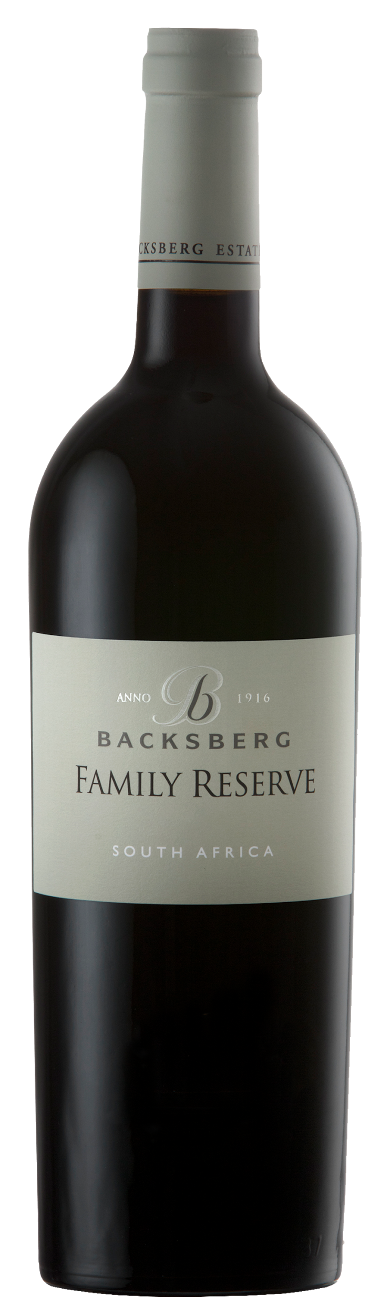
Backsberg Family Reserve
Only produced in exceptional vintages from the very best vineyard blocks, no effort is spared to create these fine wines of true personality and distinction.

Slide 14
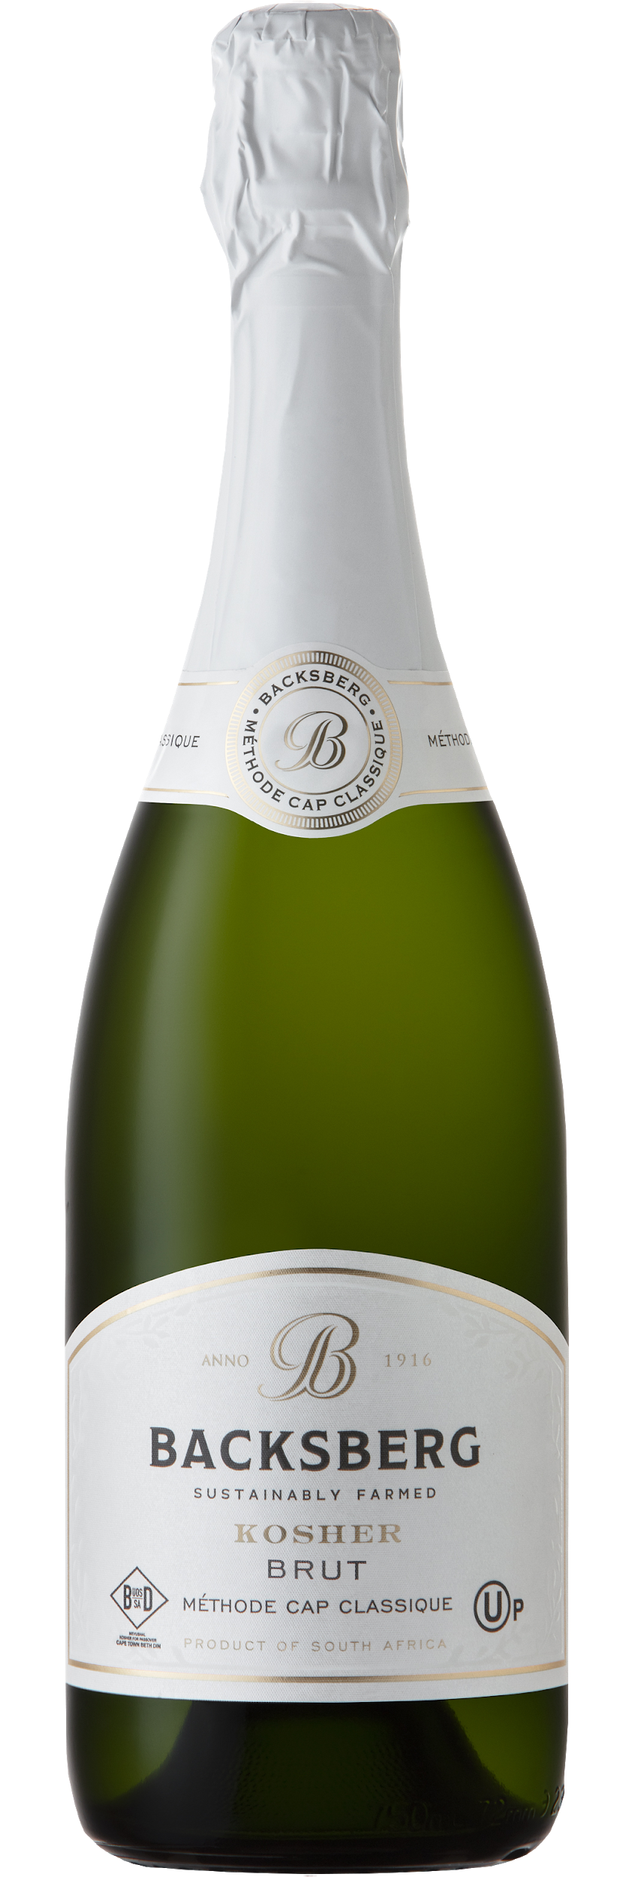
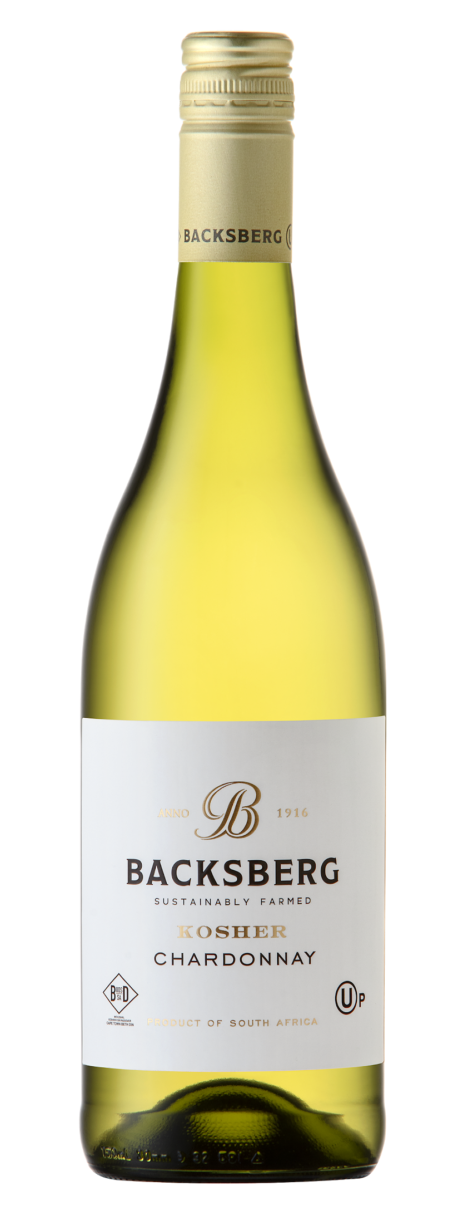
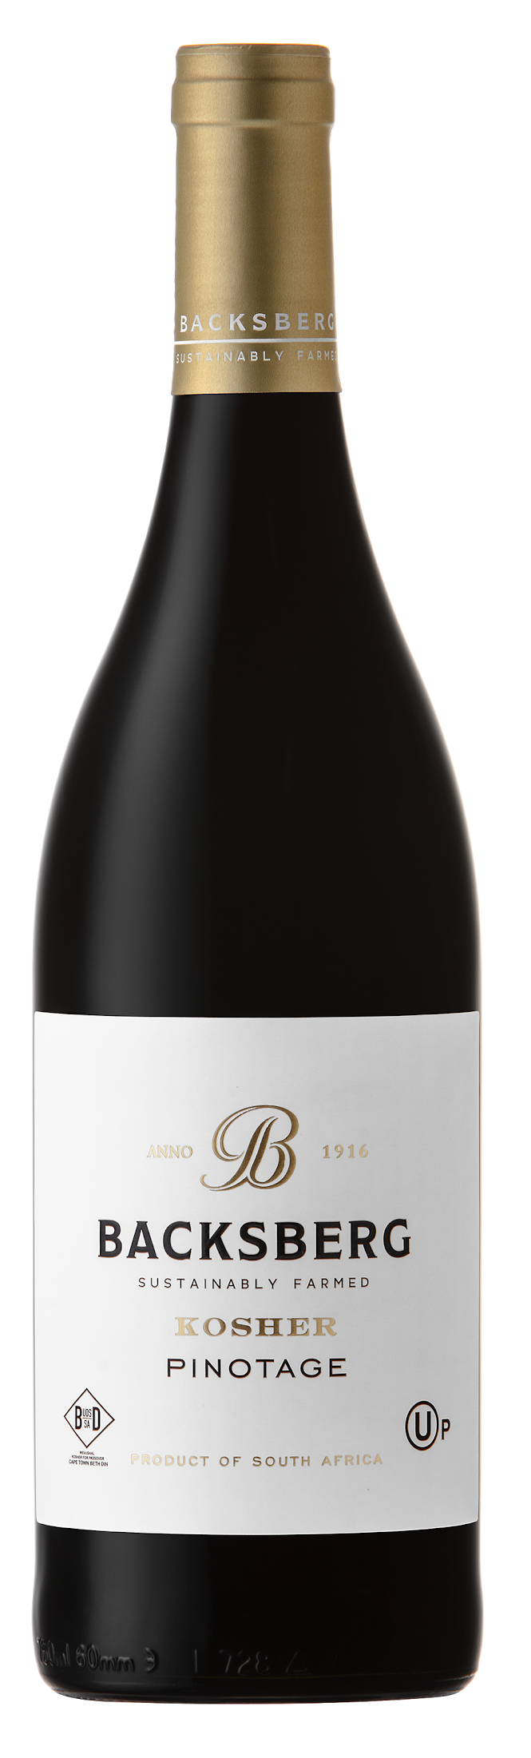
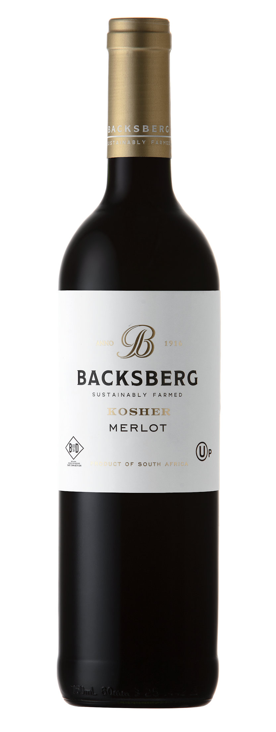
Backsberg Kosher Range
Backsberg’s Kosher range celebrates the Lithuanian Jewish roots of the Back family. Made under the auspices of the Cape Town Beth Din and the OU of the United States, these wines are Mevushal and Kosher for Passover.

Slide 15
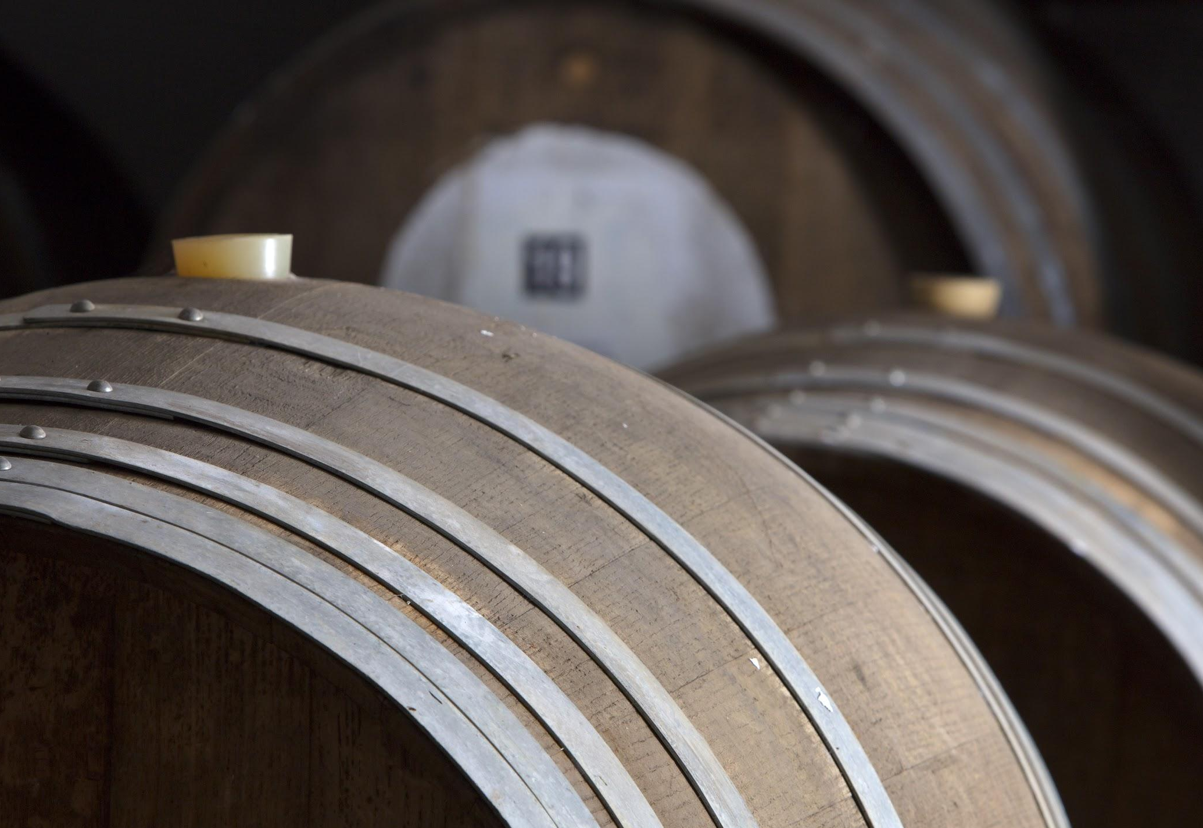

Slide 16
Contact us
For more information, contact: Bryce Gillespie, Marquee Selections
bryce@marqueewines.com | 503.313.9180 | www.marqueewines.com

Slide 17
